Slide 1
NEUROENDOCRINE TUMOURS – WHO 5th ed
Dr. Veena madhuri
Cpath labs.

Slide 2
Brief introduction
NET – malignant well differentiated epithelial neuroendocrine neoplasms.
Endocrine organs - Pituitary, parathyroid, thyroid, adrenal etc.
Non endocrine organs -
Site of occurrence : Most commonly Lung and GI, pancreas, followed by urological , MGT, FGT, breast and skin.
Head and neck – Larynx
Thorax – Lung
Digestive tract – Colon/rectum, SI
Urogenital - Kidney
Gynaec - Ovary

Slide 3
Presentation : Hormonal / mass effects
Etiology : MEN -1, VHL and NF and other known risk factors (FHx, age, site specific)
Macro : Small polypoidal lesions to ulcerated large vascular nodules.
Micro :
- Islets, nests, trabeculae, ribbons, tubules , acini, rosettte like.
- Monomorphic, medium to large, eosinophilic granular cyto, nuclei with salt and pepper type chromatin, Mitosis(as per the grade) to high grade small cell and large cell morphology.

Slide 4
1. GastroIntestinal
Classification : WD - NET (Grading)
SC NEC (NO Grading)
LC NEC
PD NEC
MiNENs
Grading – G1,2,3 - Based on Ki67 index, Mitotic figures and necrosis.
Mitosis /2mm2 – 10hpf at 40X - OD - 0.5mm
Ki67 – 500 fields in hot spots
If both have different values- higher grade is to be taken.(usually – Ki67)
NEC – High grade by definition.

Slide 5
MiNENs – NET(sometimes NEC) + non NEN (each >30%) - Grade separately.
Collision tumors, Ca previously treated with Neo. Rx and precursor lesions - Not MiNENs
Clinically – Mainly GI- pancreatic
Functioning NET – associated with clinical syndromes related to abnormal production of hormones by the neoplasm. Eg: Pancreas
Non functioning – also produce hormones – detected in serum or by IHC- no clinical symptoms.

Slide 6
NEC – PD epithelial neoplasms with morphological and iHC features of NE differentiation.
SC -NEC | Fusiform nuclei, fine granular chromatin, scant cytoplasm, nuclear moulding
LC-NEC | Round nuclei, prominent nucleoli, moderate cytoplasm.

Slide 7
G3 NET Vs NEC
 | G3NET | NEC
Genomic | MEN-1,DAXX,ATRX (Pan) Sporadic – Germline mutations in DNA repair genes – Chek2, BRCA2 etc | TP53, RB1
Morphology | Monotonous round cells with granular cytoplasm and stippled chromatin | Poorly differentiated – Small cell/Large cell Necrosis - extensive
Clinical | indolent natural history – unless high grade | Response to platinum based chemo.
Precursor | Arises from G1, G2 | Arises from precursor lesions of non NE

Slide 8
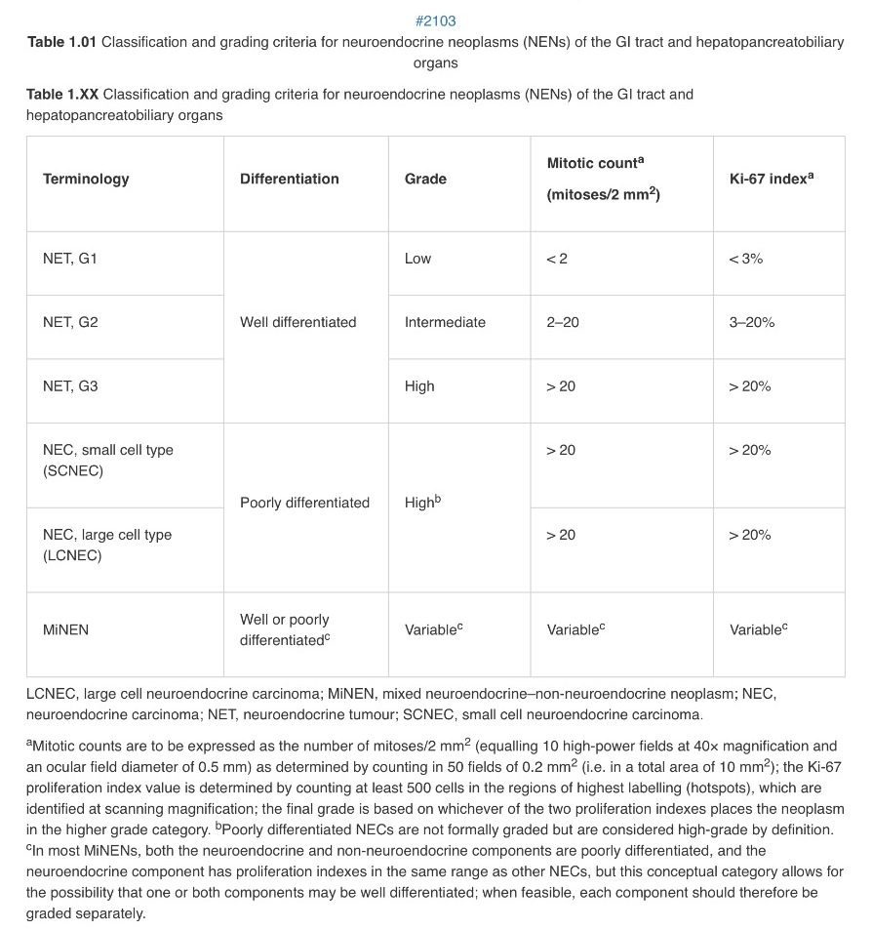

Slide 9
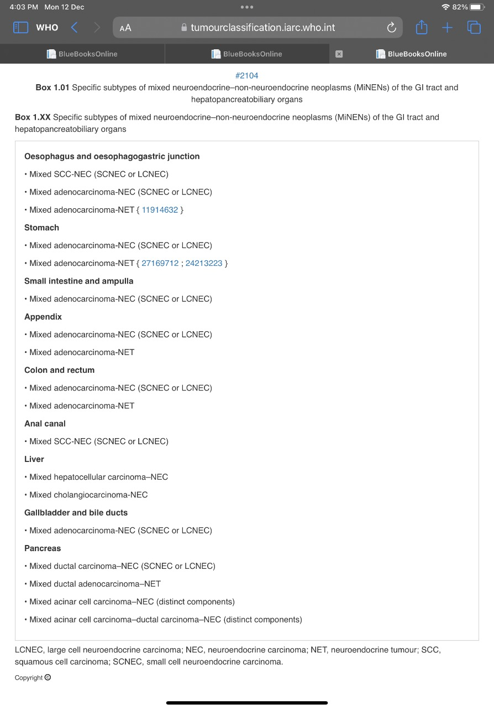

Slide 10
2. Pancreas
Pan NENs :
Pan NET - <5mm – NE micro tumours
(previously microadenomas)
Pan NEC – SC, LC
MiNENs
Functional and Non functional NETs (clinically – may produce non specific symptoms/ not classic)
Non functional > functional
>60% of all cases.
PanNEC and MiNENs – not associated with syndromes.

Slide 11
Updates…G3 Pan NET
PanNET – G1,G2,G3(earlier considered NEC).
>20% ki67, liver mets
In 2010 – These histologically bland and mitotically high tumours – NEC.
They have prognosis worse than Grade 2 NET but better then NEC.
Retain genetic abnormalities of NETs.
Clinically – 20-55% - lesser response rate but better survival than >55% (NEC)

Slide 12
3. Lung
Diffuse idiopathic pulmonary NE cell hyperplasia. (DIPNECH)
>=5NE cells singly/clusters in the BM of Br. Epi
>=3 bronchioles multifocal NEH
Preinvasive , tumourlets (nodules of <5mm) -
carcinoid
symp/asymp- non smokers/women.
Reactive NEH Vs DIPNECH/carcinoid – OTP gene dyregulation.

Slide 13
Terms – WD NET grades 1, 2 – Not recommended in Lung carcinoids.
Lung NENs –
(Low grade) Typical Carcinoid – >5mm
G1- <2mitosis/2mm2
No necrosis
Central – symptoms are common
Mets - <5%
(Intermediate grade) Atypical carcionoid –
G2- 2-10 mitosis/2mm2
+/- necrosis punctate
Peripheral – incidental
Mets – 20-30%
NEC – SC, LC
Carcinoid tumour NOS - to be used in 3 settings – small biopsies, cytology and in only for metastatic carcinoids.
In lung – 95% are NEN are HG and PD.
SCNEC – responds well to chemoRx with cisplatin and etoposide.

Slide 14
Role of Ki67 in Carcinoids Vs NEC– debatable, no cut –offs
Suggests (for resection specimens, not met. Carcinoids) – proposed - >5% are atypical carcinoids, > 30% are High grade.
Mainly in crushed areas to differentiate carcinoids Vs SCNEC/LCNEC
Mitosis/2mm2 and necrosis – primary diagnostic criterion.
For met. Carcinoids - mention mitosis, necrosis and ki67 index.
Carcinoids(AC) with high proliferative index : MC >10/2mm2 or >30% of Ki67
Mutations : MEN-1 ( G3Pan NET/?? LCNEC)
SCLC : TP53, RB1, inactivating mutations of NOTCH family.
LCLC : KRAS, STK11/KEAP1

Slide 15
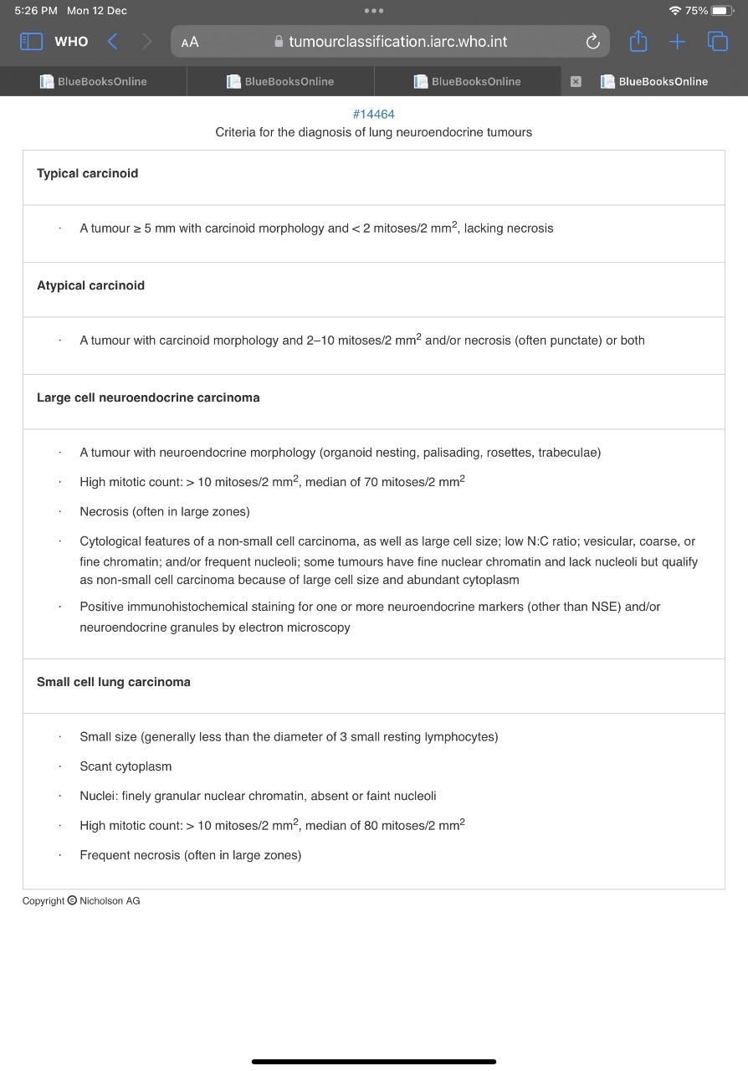

Slide 16
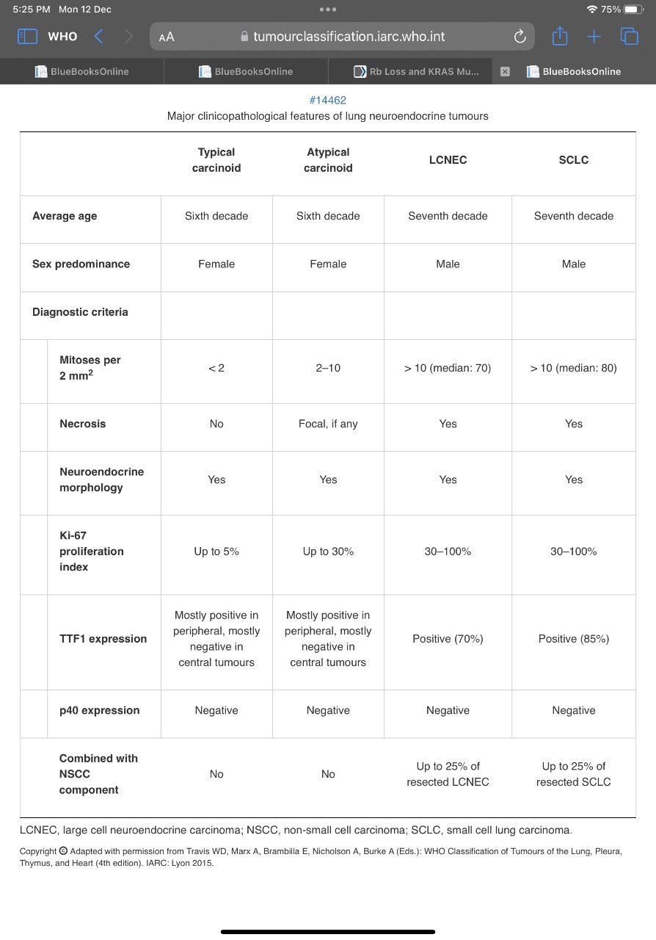

Slide 17
SCLC
Smokers
DeNovo
Secondary to TKI Rx for EGFR mutated.
Etiology : Mutations – TP53, RB-1 loss,Down regualtion of NOTCH signalling.
4 SCLC classes- recent concepts of pathogenesis and therapeutic considerations.
ASCL1 dominant type A - untreated
NeuroD1 type D
YAP1 in type Y
POU2F3 in type P

Slide 18
Morphology :
Cells are less than the diameter of 3 resting lymphocytes.
Nuclear moulding
Sheets like
Necrosis, apoptosis
Crush artefacts, azzopardi effect
Occasional larger cells - if >10% - combined
SCLC/LCNEC (not applicable to Non small cell ca)
Mitosis >10% (median – 80/2mm2)

Slide 19
Differentials
SMARCA4 Def Undiff | SCNEC | Carcinoid | Merkel cell | Basaloid SCC | SRC sarcomas | Lymphoma | Melanoma
Loss of SMARCA4 protein | Synapto, chrmo, Panck, TTF-1 | Ki67 <5% | CK20,NFP, MPV - pos TTF1 neg | P40,p63, PCK, CD56 | Ewing’s | Lymphoid markers | HMB45,S100,Melan A, SOX-10

